Slide 1
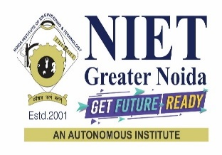


Noida Institute of Engineering and Technology, Greater Noida
Cultural Heritage and Performing Arts
(Module-V)
Module: 5
ESSENCE OF INDIAN TRADITIONAL KNOWLEDGE
(ANC 0502)
Mr. Arun Bhati
MBA
B.Tech VI semester

Slide 2

Noida Institute of Engineering and Technology, Greater Noida
Mr. Arun Bhati completed Post Graduation (PGDM) with International Business specialization (AICTE) in 2011. He also completed M Com in International Business Specialization. Along with this he has presented various papers in national and international conferences / Seminars. He also has applied for Patent on a Management Process. At present he is working as an Assistant Professor in MBA, Department, NIET Greater Noida.
He has around 11 years of experience, in Industry as well as in academic Area whereas he had taught various Graduate and under graduate students. His field of research is International Business.

Slide 3
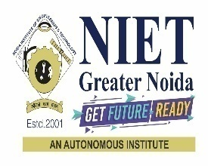
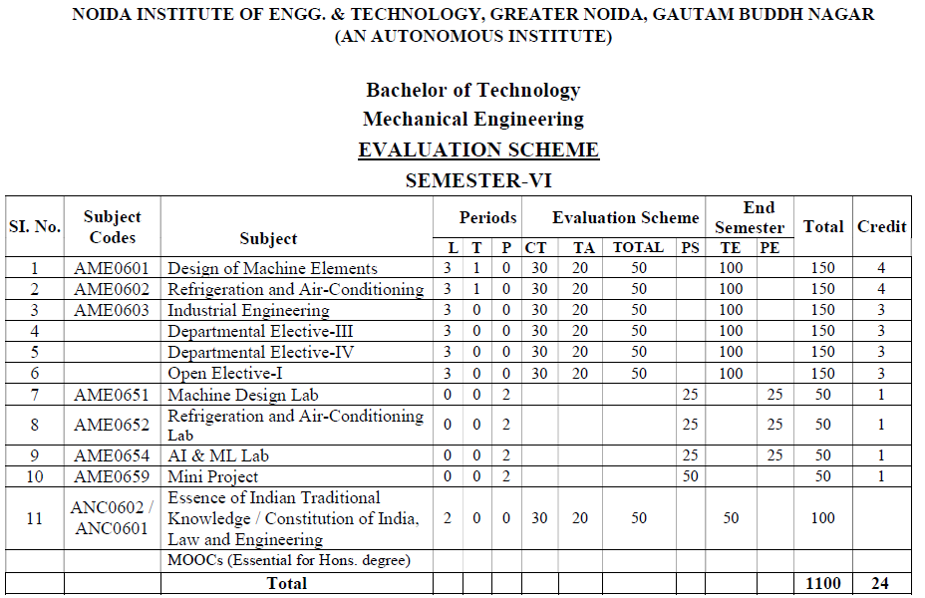
Evaluation Scheme (B.Tech - 6th Sem Non Credit)

Slide 4
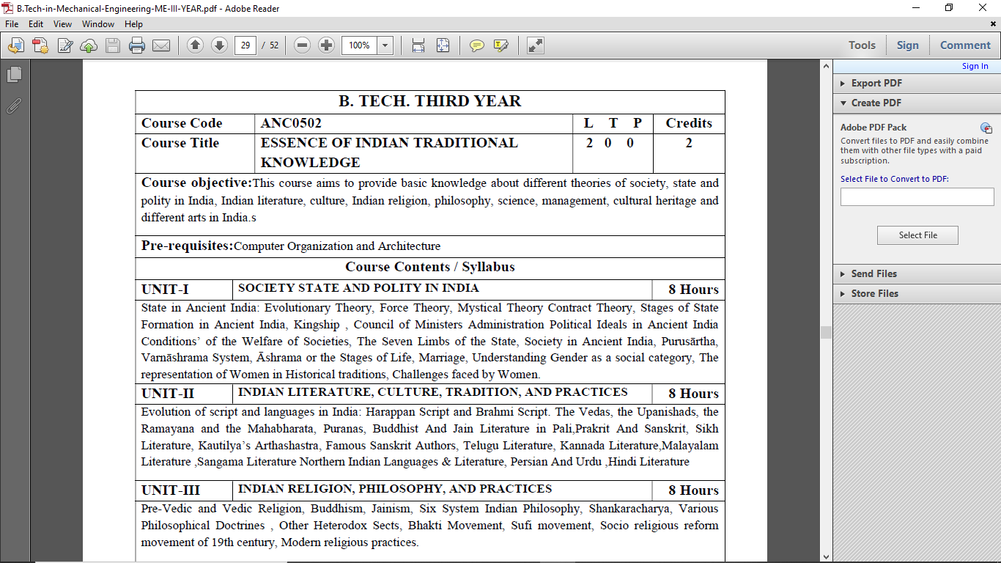
Syllabus

Slide 5
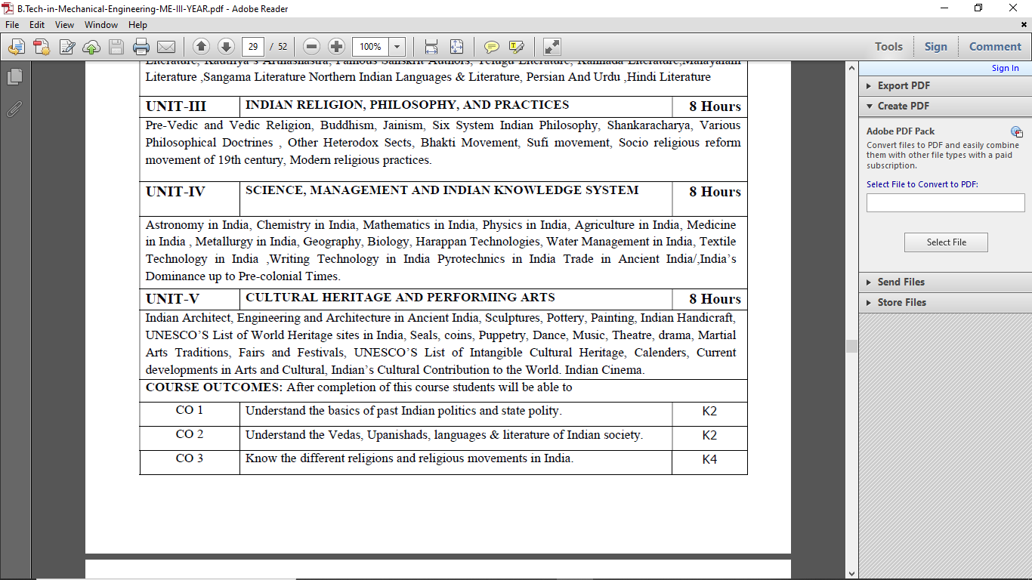
Syllabus(Continue….)

Slide 6

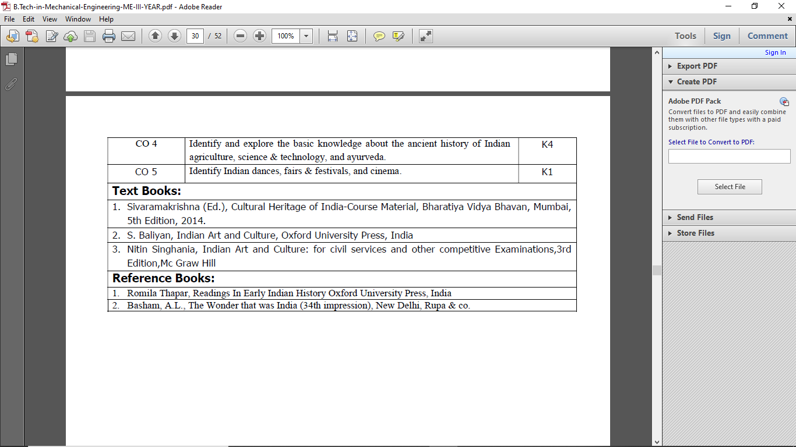
Text Books

Slide 7

Applications of Essence of Indian Traditional Knowledge
Can apply the old designing concept with blend of new trends in building construction
Learn the ancient living style
Indian Traditional knowledge modern scientific perspective
Apply the ancient advanced architectural wonders in current trends

Slide 8

Course Objective
Course Objectives:
The student will try to learn about:
To imparting the basic principles of thought process, reasoning and inference to identify the roots and details of some of the contemporary issues faced by our nation and try to locate possible solutions to these challenges by digging deep into our past.
To enable the students to understand the importance of our surroundings and encourage the students to contribute towards sustainable development.

Slide 9
Course Objective(Continue…)
To sensitize students towards issues related to ‘Indian’ culture, tradition and its composite character.
To make students aware of holistic life styles of Yogic-science and wisdom capsules in Sanskrit literature that are important in modern society with rapid technological advancements and societal disruptions.
To acquaint students with Indian Knowledge System, Indian perspective of modern scientific world-view and basic principles of Yoga and holistic health care system.

Slide 10

Course Outcome
At the end of this course students will able to:
CO 1: Understand the basics of past Indian politics and state polity.
CO 2: Understand the Vedas, Upanishads, languages & literature of Indian society.
CO 3: Know the different religions and religious movements in India.
CO 4: Identify and explore the basic knowledge about the ancient history of Indian agriculture, science & technology & Ayurveda.
CO 5: Identify Indian dances, fairs & festivals, and cinema.

Slide 11

Program Outcomes
Program Outcomes are narrow statements that describe what the students are expected to know and would be able to do upon the graduation.
These relate to the skills, knowledge, and behavior that students acquire through the programmed.
Engineering knowledge
Problem analysis
Design/development of solutions
Conduct investigations of complex problems
Modern tool usage
The engineer and society
Environment and sustainability
Ethics
Individual and team work
Communication
Project management and finance
Life-long learning

Slide 12

Program Specific Outcomes
Program Specific Outcomes (PSOs) are what the students should be able to do at the time of graduation. The PSOs are program specific. PSOs are written by the department offering the program.
On successful completion of B. Tech. (EC) Program, the Electronics and Communication engineering graduates will be able to:
PSO1: To apply the knowledge of mathematics, science and electronics & communication engineering to work effectively in the industry based on same or related area.
PSO2: To use their skills to work in modern electronics & communication engineering tools, software and equipments to design solutions for complex problems in the related field that meet the specified needs of the society.
PSO3: To function effectively as an individual and as a member or leader of a team by qualifying through examinations like GATE (Graduate Aptitude Test in Engineering), IES (Indian Engineering Services), PSUs (Public Sector Undertakings), TOEFL (Test of English as a Foreign Language), GMAT (Graduate Management Admission Test) and GRE (Graduate Record Examinations in US) etc.

Slide 13
CO-PO and PSO Mapping
CO | PO1 | PO2 | PO3 | PO4 | PO5 | PO6 | PO7 | PO8 | PO9 | PO10 | PO11 | PO12 | PSO1 | PSO2 | PSO3
CO1 | - | - | - | - | - | - | - | 3 | - | - | - | 3 | - | - | -
CO2 | - | - | - | - | - | - | - | 3 | - | - | - | 3 | - | - | -
CO3 | - | - | - | - | - | - | - | 3 | - | - | - | 3 | - | - | -
CO4 | - | - | - | - | - | - | - | 3 | - | - | - | 3 | - | - | -
CO5 | - | - | - | - | - | - | - | 3 | - | - | - | 3 | - | - | -
Avg | - | - | - | - | - | - | - | 3 | - | - | - | 3 | - | - | -
**3= High *2= Medium *1=Low

Slide 14
Program Educational Objectives
The Program Educational Objectives (PEOs) of an engineering degree program are the statements that describe the expected achievements of graduates in their career, and what the graduates are expected to perform and achieve during the first few years after graduation.
PEO1: To have an excellent scientific and engineering breadth so as to comprehend, analyze, design and solve real-life problems using state-of-the-art technology.
PEO2: To lead a successful career in industries or to pursue higher studies or to understand entrepreneurial endeavours.
PEO3: To effectively bridge the gap between industry and academics through effective communication skill, professional attitude and a desire to learn.

Slide 15
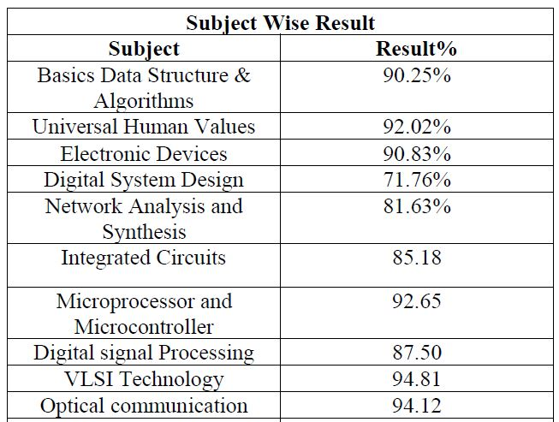
Result Analysis
Faculty Name | Subject Code | Section A | Section B | Section C | Section D
Mr. Anshu Kumar | KNC 602 | 100 % | 100 % | 100 % | 100 %

Slide 16
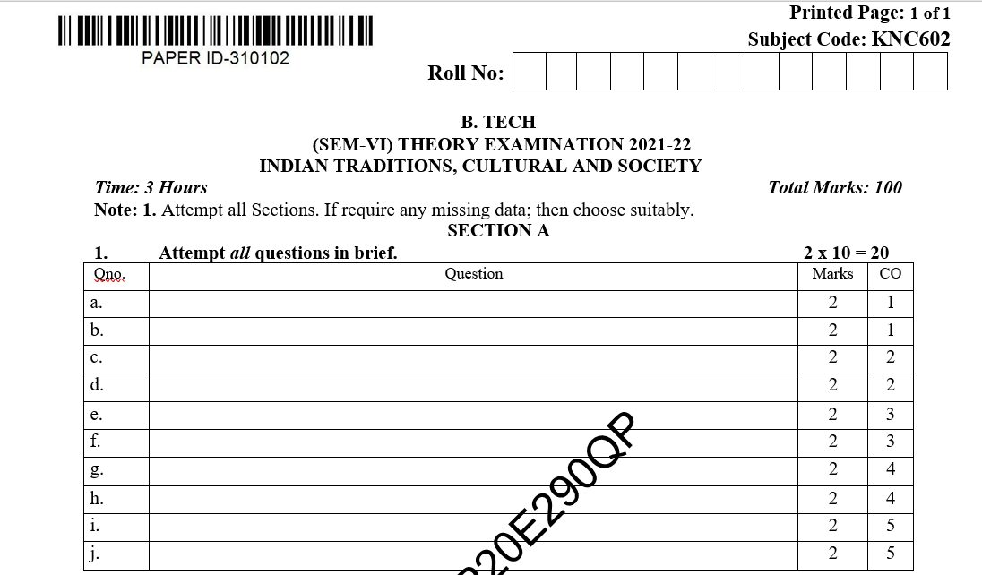
Question Paper Template

Slide 17
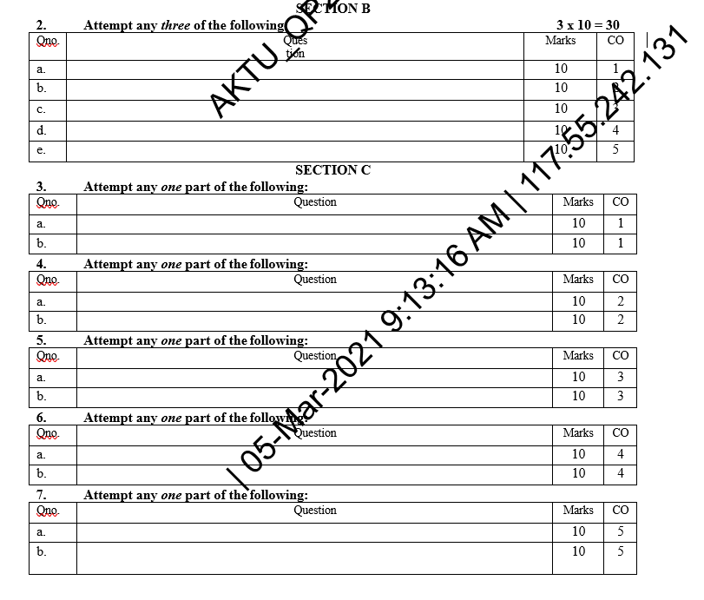
Question Paper Template (Cont……)

Slide 18
Prerequisite
Basic knowledge of Architecture
Basic knowledge of Indian Tradition & Culture.

Slide 19
Brief Introduction about the subject with Video
The course aims at imparting basic principles of thought process, reasoning and inference & to identify the roots and details of some of the contemporary issues faced by our nation and try to locate possible solutions to these challenges by digging deep into our past. To enable the students to understand the importance of our surroundings and encourage the students to contribute towards sustainable development. To sensitize students towards issues related to ‘Indian’ culture, tradition and its composite character.
https://www.youtube.com/playlist?list=PLEq2lkfJdUybp8rxTH-UscWmSv7tSAaNZ

Slide 20

Content
Indian Architect,
Engineering and Architecture in Ancient India,
Sculptures, Pottery,
Painting, Indian Handicraft,
UNESCO’S List of World Heritage sites in India,
Seals, coins, Puppetry,
Dance, Music, Theatre, drama, Martial Arts Traditions,
Fairs and Festivals,
UNESCO’S List of Intangible Cultural Heritage,
Calenders, Current developments in Arts and Cultural,
Indian’s Cultural Contribution to the World
Indian Cinema.

Slide 21
Module 5 Objective
To acquaint students with Indian Knowledge System, Indian perspective of modern scientific world-view and basic principles of Yoga and holistic health care system.

Slide 22
Topic Objective
Topic No. | Topic Objective
1 | To study the Indian Architect & Engineering and Architecture in Ancient India
2 | To study the Sculptures, Seals, coins, Pottery, Puppetry & Dance

Slide 23
Topic Mapping
S.No. | Topic | Course Outcome
1 | Indian Architect and Engineering and Architecture in Ancient India | CO5
2 | Sculptures, Seals, coins, Pottery, Puppetry, Dance. | CO5

Slide 24
Indian Architecture (CO5)
The word ‘architecture’ is derived from the Latin word ‘tekton’ which means builder. When the early man began to build his shelter to live in, the science of architecture started.
Sculpture, on the other hand, is derived from Proto-Indo-European (PIE) root ‘kel’ which means ‘to bend’.
Sculptures are small works of art, either handmade or with tools and are more related to aesthetics than engineering and measurements.
Architecture refers to the design and construction of building whereas Sculptures are relatively small 3-dimensional works of art.

Slide 25
Indian Architecture
Architecture uses a mixture of various type of materials like stone, wood, glass, metal, sand, etc. but a single piece of sculpture is usually made of a single type of material.
Architecture involves study of engineering and engineering mathematics. It requires detailed and accurate measurements whereas Sculpture involves creativity and imagination and may not depend as heavily on accurate measurements.
Example of architecture are Taj Mahal, Red Fort, etc.
Example of Sculpture are Nataraja Image, Dancing Girl, etc.

Slide 26
Indian Architecture
The story of Indian art and architecture is a story of evolution. From the ancient Indus Valley Civilisation to the British rule, the buildings and sculptures have a narrative of their own.
The emergence and decay of great empires, the invasion of foreign rulers who gradually became indigenous, the confluence of different cultures and styles, etc. are all reflected in the evolution of Indian architecture and sculpture.
Architecture is the finest expression of human creativity.
The monuments are living examples of the values, beliefs and thinking processes of the masses as well as the classes.

Slide 27
Indian Architects
Achyut Kanvinde (1916-2002):-
Achyut Kanvinde, who also worked with Modernist architect and Bauhaus founder Walter Gropius, dealt in proportional geometry, economical shapes, steel frames, and reinforced concrete.
Brinda Somaya (b. 1949) :-
To be “the conscience of the built and unbuilt environment” is the philosophy that energizes Brinda Somaya’s practice. Her work unites architecture with social equity and conservation.
She has both built and conserved structures with attention to preserving their historic significances.

Slide 28
Indian Architects
B. V. Doshi (b. 1927) :-
Before practicing in India, B.V. Doshi worked with Modernist (Supportive of art) and contemporary giants Le Corbusier and Louis Kahn. Doshi retains a Modernist edge but adds a distinctive Indian spirit.
Charles Correa (b. 1930) :-
At the frontier of contemporary Indian architecture, Charles Correa is adept at sensitively meeting needs and preserving history.
At Kanchanjunga Apartments, flats reconcile courtyards and the connected spaces of traditional living with the urban context of an apartment building.

Slide 29
Indian Architects
Laurie Baker (1917-2007):-
An Englishman who gained Indian citizenship, Laurie Baker had a deep respect for spaces stored in Indian architectural methods. Because of his value for vernacular (Mother language), organic, and sustainable architecture, he made use of traditional techniques and materials whilst also devising new ones.
Through these, he would shade places from heat, permit sunlight and ventilation, minimize materials, and provide unparalleled aesthetic beauty.

Slide 30
Engineering and Architecture in Ancient India (CO4& CO5)
Architecture in Harappan Civilisation :-
The remains of Harappa and Mohenjo-Daro reveal a remarkable sense of town planning.
The towns were laid out in a rectangular grid pattern.
The roads ran in north-south and east-west direction and cut each other at right angles.
Mainly three types of buildings have been found in the excavation sites –dwelling houses (Residential houses), public buildings and public baths. The Harappans used burnt mud bricks of standardised dimensions for the purpose of construction.

Slide 31
Engineering and Architecture in Ancient India
Mauryan Architecture:-
The remains of Harappa and Mohenjo-Daro reveal a remarkable sense of town planning.
The towns were laid out in a rectangular grid pattern.
The roads ran in north-south and east-west direction and cut each other at right angles.
Mainly three types of buildings have been found in the excavation sites –dwelling houses, public buildings and public baths. The Harappans used burnt mud bricks of standardised dimensions for the purpose of construction.

Slide 32
Engineering and Architecture in Ancient India
Mauryan Architecture:-
Wood was the principal building material.
During the reign of Ashoka, the inscription on pillars – as a symbol of the State or to commemorate battle victories – assumed great significance.
He also used pillars to propagate imperial sermons (Samrajya vistaar) as well.
On an average of 40 ft. height, the pillars were usually made of chunar sandstone and comprised of Shaft and Capital.
A long Shaft formed the base and was made up of a single piece of stone or monolith.

Slide 33
Engineering and Architecture in Ancient India
Stupa:
Stupas were burial mounds prevalent in India from the Vedic period. It is a conventional representation of a funeral cumulus in which relics and ashes of the dead were kept.
During the period of Ashoka, the art of stupas reached its climax. Almost 84,000 stupas were erected during his period.
Although a Vedic tradition, stupas were popularised by the Buddhists.

Slide 34
Engineering and Architecture in Ancient India
Cave Architecture:-
Rock-cut Caves
The construction of rock caves continued as in the Mauryan period. However, this period saw the development of two types of rock caves Chaitya and Vihar.
While the Vihars were residential halls for the Buddhist and Jain monks and were developed during the time of the Mauryan Empire, the Chaitya halls were developed during this time.
They were mainly quadrangular chambers with flat roofs and used as prayer halls.

Slide 35
Sculptures (CO4&CO5)
The art of sculpture has a glorious history in India because progress in this art form has been going on since more than 5000 years.
The Harappan sculpture is an example of popular art because these figures have been discovered from private house.
Stone sculptures :-
Limestone, alabaster (gypsum like material) and steatite (soft white stone) varieties of stone were used to make sculptures. The level of refinement in them was quite high.
Example:- dancing girl found at Harappa, bearded priest found at Mohenjo-Daro and Horse found at Lothal.

Slide 36
Sculptures
Terracotta sculptures :-
Terracotta (baked clay) was also used by Harappans to make sculptures. These figure are less sophisticated or refined when compared to metal or stone figures.
Example:- An animal resembling horse found at Mohenjo-Daro.
Copper and Bronze Sculptures:-
The lost wax method was used by Harappans to make sculptures.
The figure of the Bronze Dancing girl found at Mohenjo-Daro is one of the finest examples.

Slide 37
Seals (CO5)
Seals were used to make a sealing, or positive imprint, like this modern resin one made from the original seal.
Numerous Indus seals have been found in ancient Mesopotamian cities.
There is evidence for settlements of Indus valley traders in ancient Mesopotamia, in the form of Mesopotamian seals with Indus language characters.

Slide 38
Coins (CO5)
The word Coin is derived from the Latin word Cuneus (Kuneous) and it is believed that the first recorded use of coins was in China and Greece around 700 BC and in India in the 6th century BC.
The study of coins and medallions is known as Numismatics.
The earliest coins were casted coins and were die-struck only on one side. One to five marks or symbols were incused on single side and were termed as ‘Punch Marked’ coins.

Slide 39
Pottery (CO5)
The potteries found at the excavation sites can be broadly classified into two kinds – plain pottery and painted pottery.
The painted pottery is also known as Red and Black Pottery as it used red colour to paint the background and glossy black paint was used to draw designs and figures on the red background.

Slide 40
Puppetry
Puppetry is one of the ancient forms of entertainment.
This form of entertainment gives unrestricted freedom to the artist in design, colour and movement making it one of the most ingenious inventions of mankind.
The excavation sites at Harappa and Mohenjo-daro have yielded puppets with sockets attached to them, which suggest the presence of puppetry as an art form even during those days.

Slide 41
Dance (CO5)
As per Natya Shastra, there are two basic aspects of Indian classical dance.
1. Lasya – It denotes grace, bhava, rasa and abhinaya. It is symbolic to
the feminine features of dance as an art form.
2. Tandava – This is symbolic to the male aspects of dance and has
more emphasis on rhythm and movement.
Most of the Kuchipudi recitals are based on stories of Bhagwata purana.

Slide 42
Recap
In this topic, We learned about Indian Architect, Engineering and Architecture in Ancient India.
We also learned about Sculptures, Seals & coins, Pottery, Puppetry & Dance.

Slide 43
Topic video link
YouTube/other Video Links
https://www.youtube.com/watch?v=PNj83l3dlHg
https://www.youtube.com/watch?v=ZMF2oBc0VzI
https://www.youtube.com/watch?v=a_qWYsBIX7I
https://www.youtube.com/watch?v=cfyRXRGM9h4
https://www.youtube.com/watch?v=rrqgHmSebl8
https://www.youtube.com/watch?v=YfswS66utPE
https://www.youtube.com/watch?v=5Fthlj0gkv4

Slide 44
Daily Quiz
‘Jaubani’ is a dance form traditionally performed in north eastern India by the
A. Dimasas
B. Khasis
C. Mizos
D. Bodos
Which of the following is the classical dance that belong to the state of Andhra Pradesh?
A. Kathakali
B. Odisi
C. Kuchipudi
D. Bharatanatyam
‘Sattriya’ is the classical dance belonging to the state of Assam.
A. True
B. False

Slide 45
Daily Quiz
‘Odishi’ is the classical dance belonging to the state of ______.
A. Tamilnadu
B. Andhra Pradesh
C. Odisha
D. Assam
What does stupa signify?
A. Death
B. Knowledge
C. Birth
D. Parinirvana
The Nagara style of architecture developed and flourished mainly in north India.
A. True
B. False

Slide 46
Daily Quiz
The arrival of Babur into India led to the
(i) introduction of gunpowder in the subcontinent
(ii) introduction of the arch and dome in the region’s architecture
(iii) establishment of Timurid dynasty in the region
Select the correct answer using the code given below.
(a) (i) and (ii) Only
(b) (iii) Only
(c) (i) and (iii) Only
(d) (i), (ii) and (iii)
With reference to the cultural history of India, the term Panchayatan refers to?
(a) An assembly of village elders (b) A religious sect
(c) A style of temple construction (d) An administrative functionary

Slide 47
Weekly Assignment
To what extent has the urban planning and culture of the Indus Valley Civilisation provided inputs to the present day urbanisation?
Why is Laurie Baker called “The Conscience Keeper of Indian Architecture”?
What are the difference between Architecture & Sculpture ?

Slide 48
Prerequisite
Basic knowledge of Indian Art.

Slide 49
Topic Objective
Topic No. | Topic Objective
1 | To study the Music, Theatre, drama, Painting, Martial Arts Traditions and the Fairs and Festivals
2 | To study the Current developments in Arts and Cultural and the Indian’s Cultural Contribution to the World
3 | To study the Indian Cinema

Slide 50
Topic Mapping
S.No. | Topic | Course Outcome
1 | Music & Theatre, Drama, Painting & Martial Arts Traditions, | CO5
2 | Fairs and Festivals, Current developments in Arts and Cultural | CO5
3 | Indian’s Cultural Contribution to the World & Indian Cinema | CO5

Slide 51
Music (CO5)
Music is the soul of any culture and India has had a long tradition of musical ingenuity.
Literary traces of music can be found for the first time two thousand years ago in the Vedic times. All the seven notes of the raga Kharaharapriya can be found in the descending order in Sama Veda.
There are three main pillars of Indian classical music: Raga, tala and swara.
While the historical roots of both the music types belong to the Bharata’s Natyashastra, they diverged in the 14th century.

Slide 52
Theatre (CO5)
It has been assumed that the excavated ruins at Sitabena and Jogimara caves represent the world’s oldest amphitheatres.
Theatre in India began as a narrative art form, which encompassed a concoction (Mixer) of music, dance and acting. Recitation, dance and music were integral parts of theatre.
The Sanskrit word ‘nataka’ was derived from the root word ‘nata’ which actually meant a dancer.

Slide 53
Drama (CO5)
Drama is a narrative art form combining acting, music, dance etc.
Bharat Muni, the author of Natya Shastra, is often called the father of Indian drama.
Drama is a variant of performing art in which stories are enacted by using dialogue, dance, music and acting.
A number of great drama writers were there in India during the ancient age. Among them Bhasa, Kalidas, Vishakhadatta were the most prominent ones.
Ashvaghosha was the first playwright in Indian history.

Slide 54
Painting (CO5)
The history of painting can be traced through the ancient and medieval period where the books were illustrated with paintings.
The history of paintings can be known from primitive rock paintings of Bhimbetaka, Mirzapur and Panchmarhi.
The work on the walls or a solid structure are referred to as Murals.
These have existed in India since ancient times and can be dated between 10th century BC and 10th century AD.

Slide 55
Martial Arts Traditions (CO5)
Martial art literally means ‘arts associated with waging of war’.
One of the oldest martial arts in India, Kalaripayattu, although practiced in most parts of Southern India, originated in the state of Kerala around 3rd century BC.
This art form includes mock duels (armed and unarmed combat) and physical exercises.
Silambam, a kind of staff fencing, is a modern and scientific martial art of Tamil Nadu.
One of the most ancient martial arts of Manipur, Cheibi Gad-ga involves fighting using a sword and a shield.

Slide 56
Fairs and Festivals (CO5)
Festivals and fairs forms an intrinsic part of Indian culture being an outpouring medium of our beliefs and emotions.
Diwali or Deepawali:- It is the festival of lights celebrated on the on New moon (Amavasya) day in the month of Kartik.
Holi It is the festival of Colours and is celebrated by people across the religion.
Eid-ul-Fitr :- The festival falls after the last day of the holy month of Ramadan (Ramzan), which is the ninth month of the Islamic calendar.
Christmas :- This day is celebrated all across the world as the birth anniversary of Jesus Christ.

Slide 57
Current developments in Arts and Cultural (CO5)
Sanskriti Kumbh, a 29 days Cultural extravaganza organised at Kumbh Mela Area, Prayagraj from 10th January, 2019.
New campus of National Museum Institute inaugurated at Noida on 30th January, 2019.
The 20th edition of Bharat Rang Mahotsav (BRM), the international theatre festival of India, is organized by National School of Drama.
Foundation Stone of Taj View Garden on the Taj Corridor Area between the Agra Fort and TajMahal in Agra was laid on 14thFeburary, 2019.
The ‘Azaadi ke Diwane’ museum was inaugurated at Red Fort, Delhi on 4th March, 2019.

Slide 58
Indian’s Cultural Contribution to the World (CO4 & CO5)
Spread of Indian religion and philosophy.
Spread of Mathematics, Astronomy and Medical science.
Spread of Indian art and architecture.
Spread of Indian languages.
Spread of Indian games and leisure activities.
1. Chess
2. Ludo
3. Krida-Patram
4. Kho-Kh0

Slide 59
Indian Cinema (CO5)
The Lumiere Brothers who are famous as the inventors of Cinematograph brought the concept of motion pictures to India. They exhibited six-soundless short films in Bombay in 1896, which managed to engross the audience.
Shot by an unknown photographer in 1897, the first film was titled Coconut Fair and Our Indian Empire.
Dadasaheb Phalke who produced the film titled Raja Harishchandra in 1913 made the first indigenous Indian silent film.

Slide 60
Recap
In this topic ,we learned about Music, Theatre, drama &Painting, Martial
Arts Traditions, the Fairs and Festivals
We have also learned the Current developments in Arts and Cultural,the Indian’s Cultural Contribution to the World & the Indian Cinema.

Slide 61
Topic video link
YouTube/other Video Links
https://www.youtube.com/watch?v=5Fthlj0gkv4
https://www.youtube.com/watch?v=VT7FLIPtWTA
https://www.youtube.com/watch?v=RkNwjYUpEvQ
https://www.youtube.com/watch?v=xtKGcJTRe64
https://www.youtube.com/watch?v=oSCDKCNWg6g
https://www.youtube.com/watch?v=-3nW57Lb0II
https://www.youtube.com/watch?v=DlXpn8aFs0I
https://www.youtube.com/watch?v=rcdsLeSHWds&t=811s

Slide 62

Daily Quiz
______was the first talkative movie.
A. Harishchandra
B. Alamara
C. Mother India
D. Pancholi
With reference to the cultural history of India, the term Panchayatan refers to?
(a) An assembly of village elders
(b) A religious sect
(c) A style of temple construction
(d) An administrative functionary
One of the oldest martial arts in India, Kalaripayattu originated in the state of Kerala around 3rd century BC.
A. True
B. False

Slide 63
Daily Quiz
To which school of painting Bani-Thani was related?
A. Bundi School
B. Kishangarh school
C. Chawand School
D. Jaipur School
Puppetry is divided into ___categories.
(a) 4
(b) 5
(c) 3
(d) 2
The Lumiere Brothers brought the concept of motion pictures to India.
A. True
B. False

Slide 64
Daily Quiz
To which school of painting Bani-Thani was related?
A. Bundi School
B. Kishangarh school
C. Chawand School
D. Jaipur School
‘Gatka’ is a _____form of martial arts.
(a) unarmed
(b) weapon based
(c) some time weapon based and some time unarmed
(d) No of the above
Glove Puppets also known as Hand puppets.
A. True
B. False

Slide 65
Weekly Assignment
Write about the chief features of the town planning in Indus Valley Civilisation?
Explain the development of painting in India.

Slide 66
Video Link
(Architecture)
https://www.youtube.com/watch?v=PNj83l3dlHg

Slide 67
Faculty Video Links, YouTube & NPTEL Video Links and Online Courses Details
YouTube/other Video Links
https://www.youtube.com/watch?v=PNj83l3dlHg
https://www.youtube.com/watch?v=ZMF2oBc0VzI
https://www.youtube.com/watch?v=a_qWYsBIX7I
https://www.youtube.com/watch?v=xtKGcJTRe64
https://www.youtube.com/watch?v=oSCDKCNWg6g
https://www.youtube.com/watch?v=-3nW57Lb0II
https://www.youtube.com/watch?v=DlXpn8aFs0I
https://www.youtube.com/watch?v=rcdsLeSHWds&t=811s

Slide 68
MCQs
‘Odishi’ is the classical dance belonging to the state of ______.
A. Tamilnadu
B. Andhra Pradesh
C. Odisha
D. Assam
What does stupa signify?
A. Death
B. Knowledge
C. Birth
D. Parinirvana
The Nagara style of architecture developed and flourished mainly in north India.
A. True
B. False

Slide 69
MCQs
The arrival of Babur into India led to the
(i) introduction of gunpowder in the subcontinent
(ii) introduction of the arch and dome in the region’s architecture
(iii) establishment of Timurid dynasty in the region
Select the correct answer using the code given below.
(a) (i) and (ii) Only
(b) (iii) Only
(c) (i) and (iii) Only
(d) (i), (ii) and (iii)
With reference to the cultural history of India, the term Panchayatan refers to?
(a) An assembly of village elders (b) A religious sect
(c) A style of temple construction (d) An administrative functionary

Slide 70
MCQs
To which school of painting Bani-Thani was related?
A. Bundi School
B. Kishangarh school
C. Chawand School
D. Jaipur School
Puppetry is divided into ___categories.
(a) 4
(b) 5
(c) 3
(d) 2
The Lumiere Brothers brought the concept of motion pictures to India.
A. True
B. False

Slide 71
Glossary Questions
Pick the correct answer from given Glossary
Gajapati Prataparudradeva P K Gode Brahmagupta Kapil Muni
1. Brahmasputa Siddhanta was written by______.
2. “History of Fireworks in India between 1400 and 1900” written by____.
3. Kautukachintamani was written by_____.
4. _____ was the founder of Yoga School of Philosophy.

Slide 72
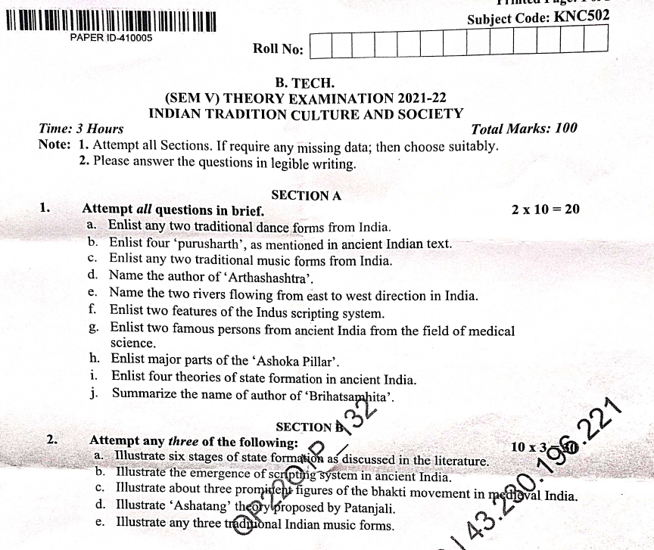
Old Question Papers

Slide 73

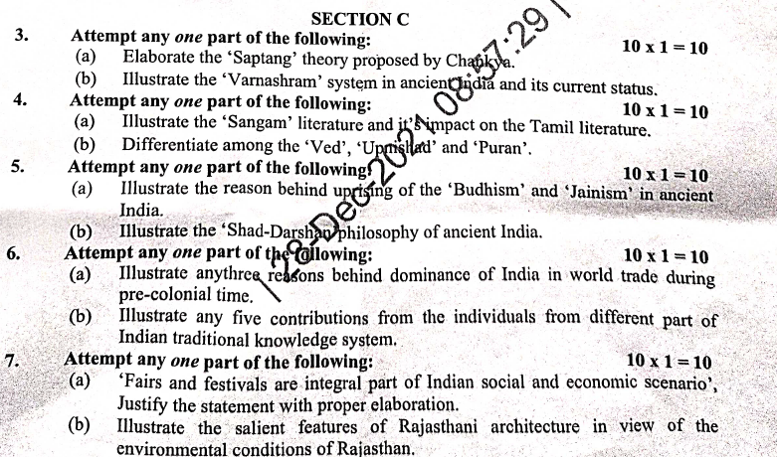
Old Question Papers

Slide 74
Expected Questions for University Exam
To what extent has the urban planning and culture of the Indus Valley Civilisation provided inputs to the present day urbanisation?
Why is Laurie Baker called “The Conscience Keeper of Indian Architecture”?
What are the difference between Architecture & Sculpture ?
Write about the chief features of the town planning in Indus Valley Civilisation?
Architecture, with the arrival of Mughals, saw a pragmatic shift both in style as well as theme. Critically examine.

Slide 75
Recap of unit
In this unit, we learned about Indian Architect, Engineering and Architecture in Ancient India
We also studied, Sculptures, Seals, coins, Pottery, Puppetry, Dance, Music, Theatre, drama, Painting, Martial Arts Traditions.
In this unit, Fairs and Festivals, Current developments in Arts and Cultural
We also studied, Indian’s Cultural Contribution to the World and Indian Cinema

Slide 76
References
V. Sivaramakrishna (Ed.), Cultural Heritage of India-Course Material, Bharatiya Vidya Bhavan, Mumbai, 5th Edition, 2014
S. Baliyan, Indian Art and Culture, Oxford University Press, India
Romila Thapar, Readings In Early Indian History Oxford University Press , India
P R Sharma ( English translation), Shodashang Hridayam
Basham, A.L., The Wonder that was India (34th impression), New Delhi, Rupa & company
Sharma, R.S., Aspects of Political Ideas and Institutions in Ancient India(fourth edition), Delhi, Motilal Banarsidass
Thank You

